Slide 1

Visualising the impact of Covid-19 on the US Economy
Munisha Sharma
Neil Tejnani
Steve Luk

Slide 2
Research Significance
Aim
The COVID-19 pandemic is one of the deadliest global pandemics in history:
6.35+ million deaths
Negatively impacted world economy
Shocked financial markets, led to recessions
Popular US stock market benchmarks can assess the economic impact of COVID-19 on the US market:
S&P 500, Dow Jones Industrial Average,Nasdaq Composite
Constant market fluctuations + ongoing Covid-19 outbreak
Other similar research ✖ updated findings and insights
Confounding variables analyses:
Preliminary comparison of magnitude of Covid-19 effects alone + the aggregated effects of other variables such as US inflation rate
To offer advice on investment strategies to different stakeholders
Hypothesis
We hypothesize that future Covid-19 waves could cause future potential market upheavals again.

Slide 3
Business Value for Stakeholders
We will assess whether the information extracted from this analysis can be used to offer investment strategies to different stakeholders on their investments about the future potential market upheavals as a result of Covid-19.
01
Investors in the US Stock Market
Investors and shareholders based worldwide
Stakeholders of Listed Companies
02
Employees, Employers, and Clients all over the world
03
US & Foreign Governments
04
Consulting Industry

Slide 4
Data Collection Process
Scraping Data from Relevant Websites
Data Cleaning
Creating Dataframes & Plots
Gaining Insights from Graphs
Importing:
Requests
BeautifulSoup
Pandas
Numpy
Using:
For loops
indexing/slicing
Cleaning null values
Extending data
Combining:
Covid DataFrames
Stock DataFrames
Inflation DataFrame
Inferring from:
Graphs
Correlation Data

Slide 5
Covid-19 Variables
Daily New Cases
First variable considered to make inferences about the economy
Daily New Deaths
Additional variable considered
Vaccination Rate
A helpful measure of society’s resistance to the virus as it can reduce Covid-19’s negative impact on the economy

Slide 6
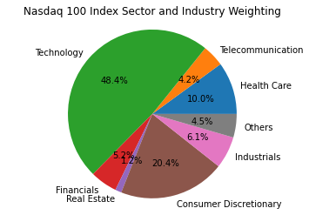
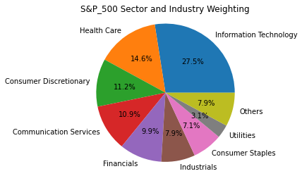
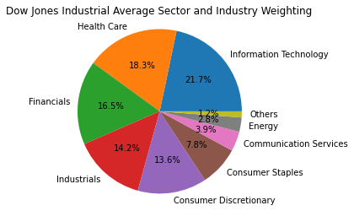
Economic Variables
S&P 500
NASDAQ
Dow Jones Index
Inflation Rate

Slide 7
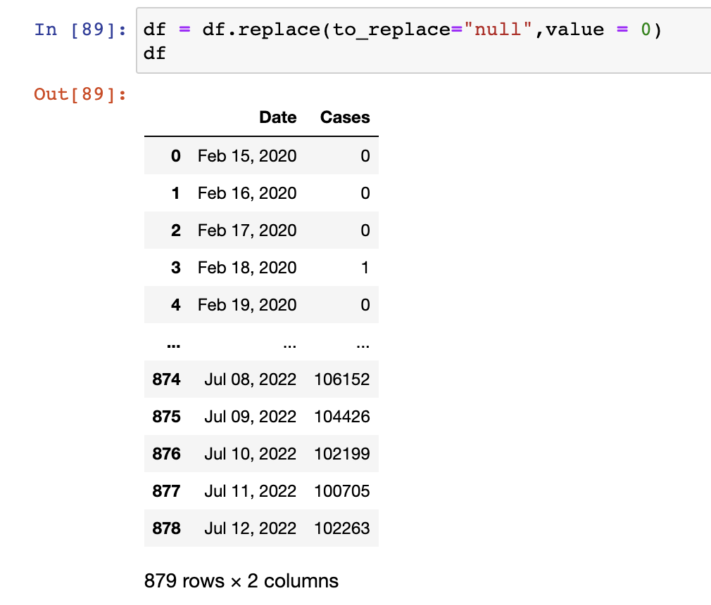
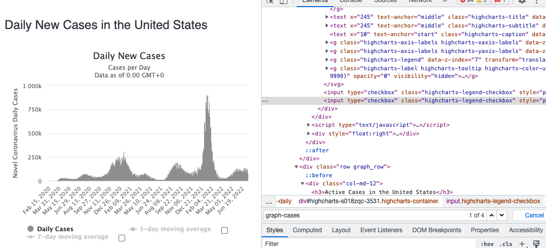
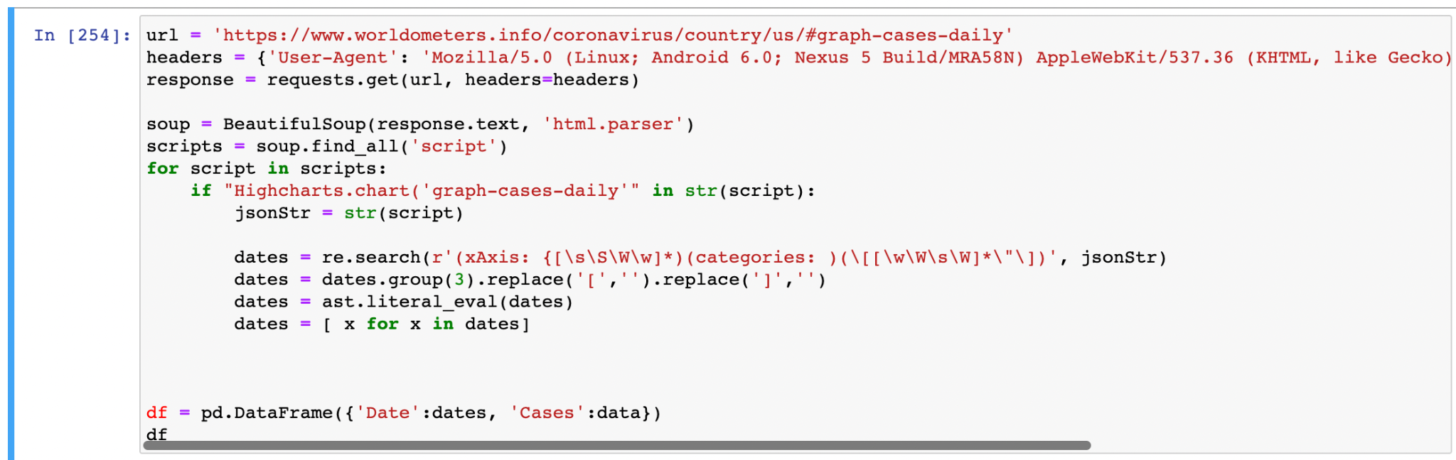
Data Preprocessing & Cleaning: Covid-19
Using bs4 to scrape the daily new cases and deaths displayed on worldometers.com.
https://www.worldometers.info/coronavirus/country/us/
(i) extracting the data from the URL
(ii) converting it into a dataframe

Slide 8
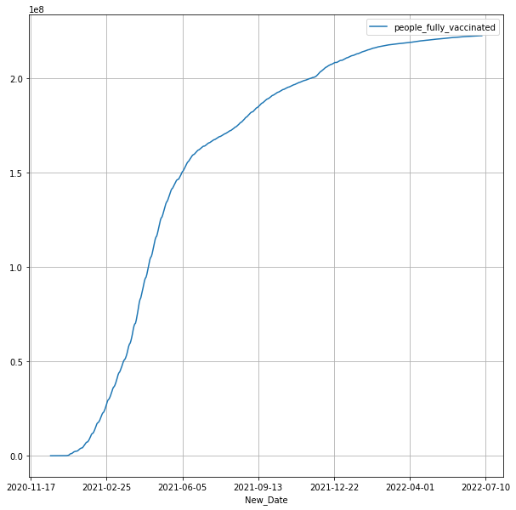
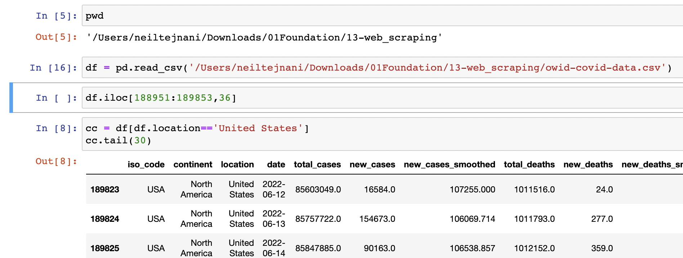
Data Preprocessing & Cleaning: Covid-19
Using a .csv file to find the vaccination rates.
https://www.worldometers.info/coronavirus/country/us/
(i) narrowing down the information using iloc, cleaning data, removing null values
(ii) changing the datetime format to match the datetime format of the stock dataframe before merging them

Slide 9
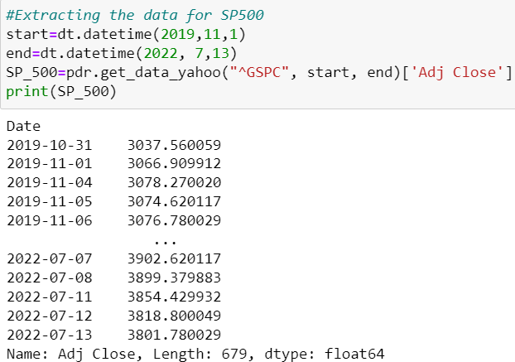
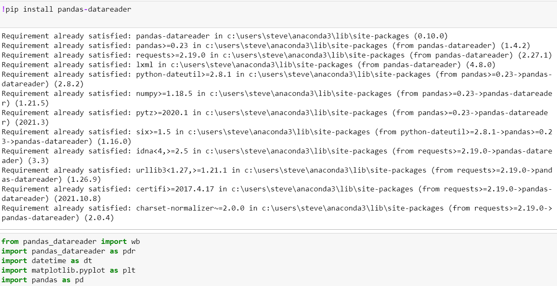
Data Preprocessing & Cleaning: Stocks
Data extraction by calling the pandas-datareader library to extract data from Yahoo Finance
ExtractIng market data (S&_500)

Slide 10
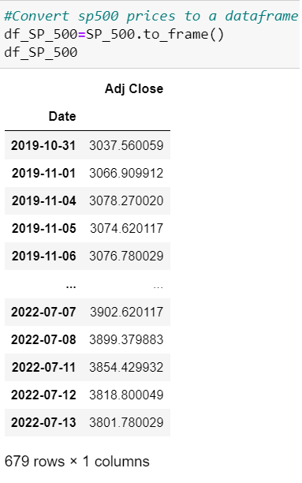
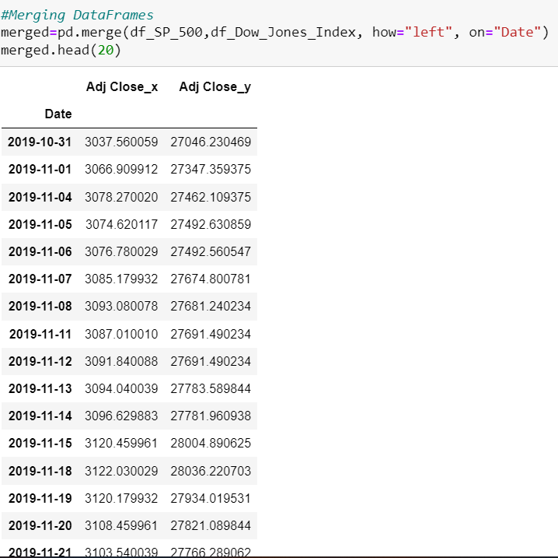
Data Preprocessing & Cleaning: Stocks
Converting extracted data into dataframe:
Merging dataframes of the 3 indices (S&P500, Dow Jones Industrial Average, Nasdaq)

Slide 11
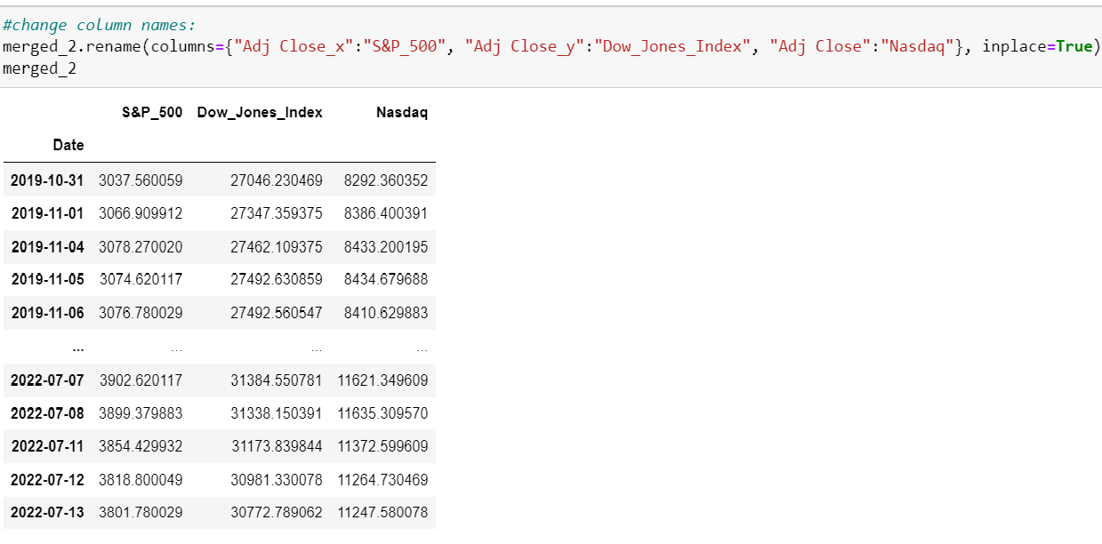
Data Preprocessing & Cleaning: Stocks
Renaming columns in the dataframe for clear presentation:

Slide 12
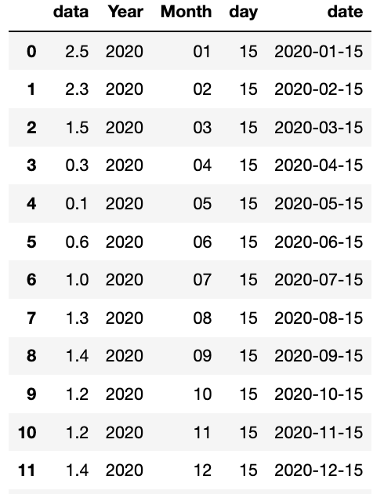
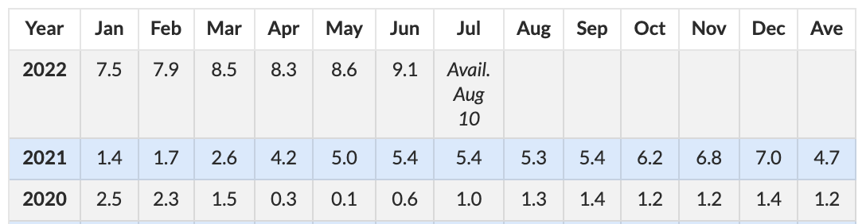
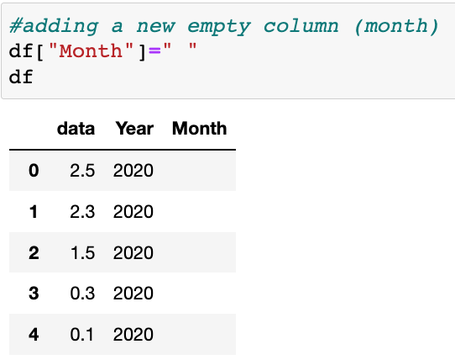
Data Preprocessing & Cleaning: Inflation rate
Extract the data from: https://www.usinflationcalculator.com/inflation/current-inflation-rates/
2. Import request and using bs4 to scrape of the data in the table
3. Use “drop” to remove unnecessary data. Created “Year, Month and Day columns to create date using “.loc”.
5. Created a function using lambda to combine the “Year, Month and Day columns to a date.
4.. Use “drop” to remove unnecessary data. Created “Year, Month and Day columns with values using “.loc”.

Slide 13
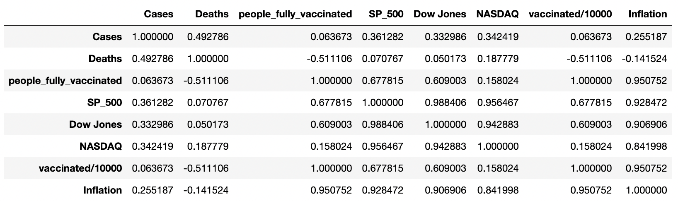
Data Preprocessing & Cleaning: Final Stage
After merging all the stock and covid data together, we created a correlation matrix, as well as several plots.
Notes:
Use a heatmap with some annotations instead of correlational matrix!!!!!!!!!
Use multivariate analysis :
Use sentimental analysis
Use panel data analysis, or time series analysis
Put some screenshots of the data cleaning !!!!!!!!!!!!!!!!

Slide 14
Analysis

Slide 15
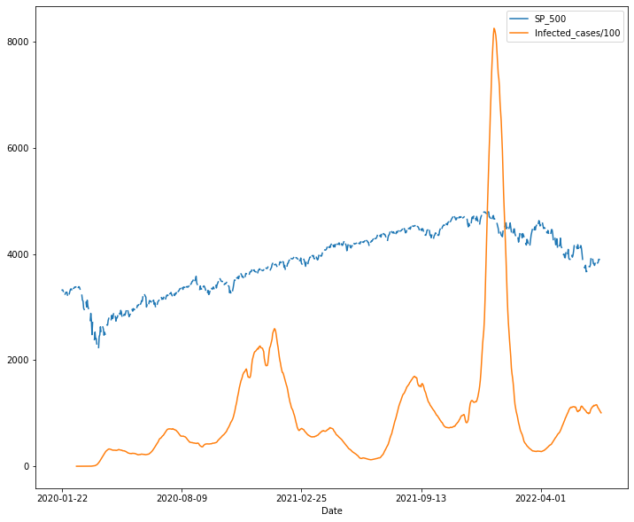
Analysis
Correlation : 0.361
Daily new cases/100 with the S&P 500:
First wave hit, sharp decline in the S&P 500 Index, with a 26% drop.
Cases rise, a tiny drop in the index, but recovers quickly despite continue rise in cases.
Huge wave of infections at the beginning of 2022, index has continued to fall.
Although there is a correlation, but the fall can be due to many other factors, e.g. the inflation rate, etc.
A rather weak correlation

Slide 16
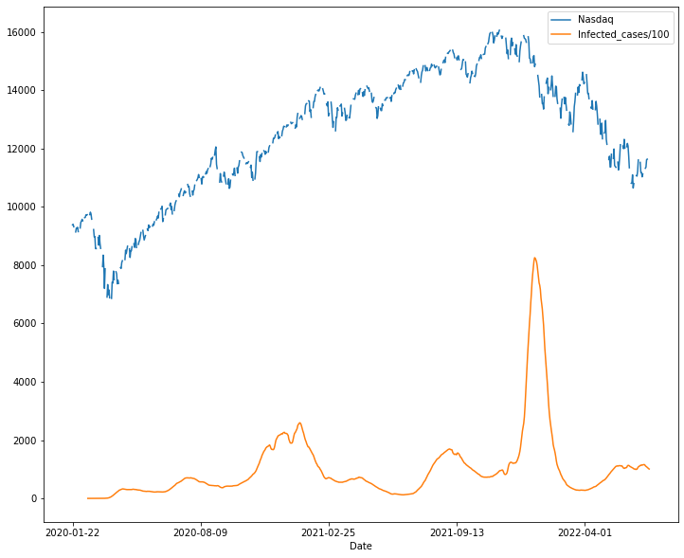
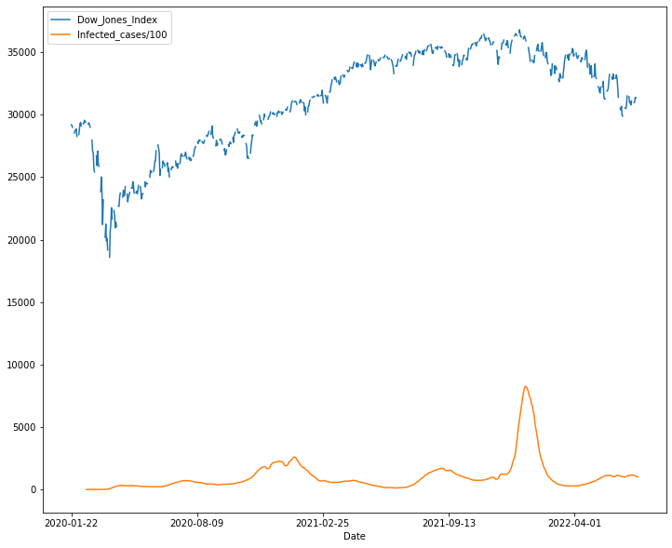

Slide 17
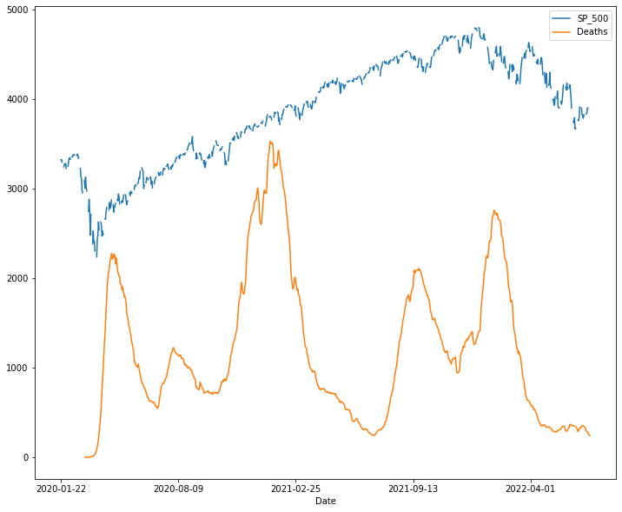
Analysis
Correlation : 0.070
Daily new deaths with the S&P 500:
During the first wave in 2020, the S&P 500 dropped significantly.
When daily deaths were at their maximum levels, the stock still managed to grow.
Speculated that this is because people were beginning to adjust to the new online way of life.
At the end the stock index started a downward trend, which coincides with the increase in deaths.
No correlation, but correlated in 2020 and 2022

Slide 18
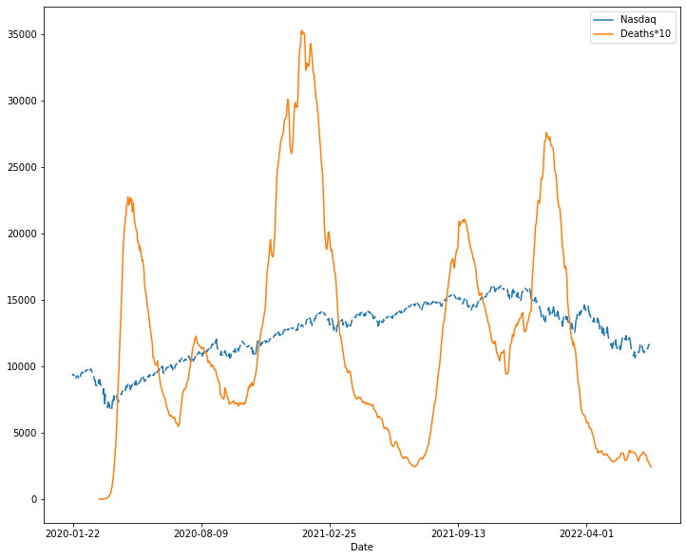
Analysis
Correlation : 0.187
Daily new deaths with NASDAQ:
NASDAQ didn't fall too much as a result of the increase in deaths in 2021 either
Because NASDAQ is comprised of 58% of Tech and Healthcare stocks
These stocks did exceptionally well during the pandemic.
There a very weak correlation.
A very weak correlation, stronger in 2020 and 2022

Slide 19
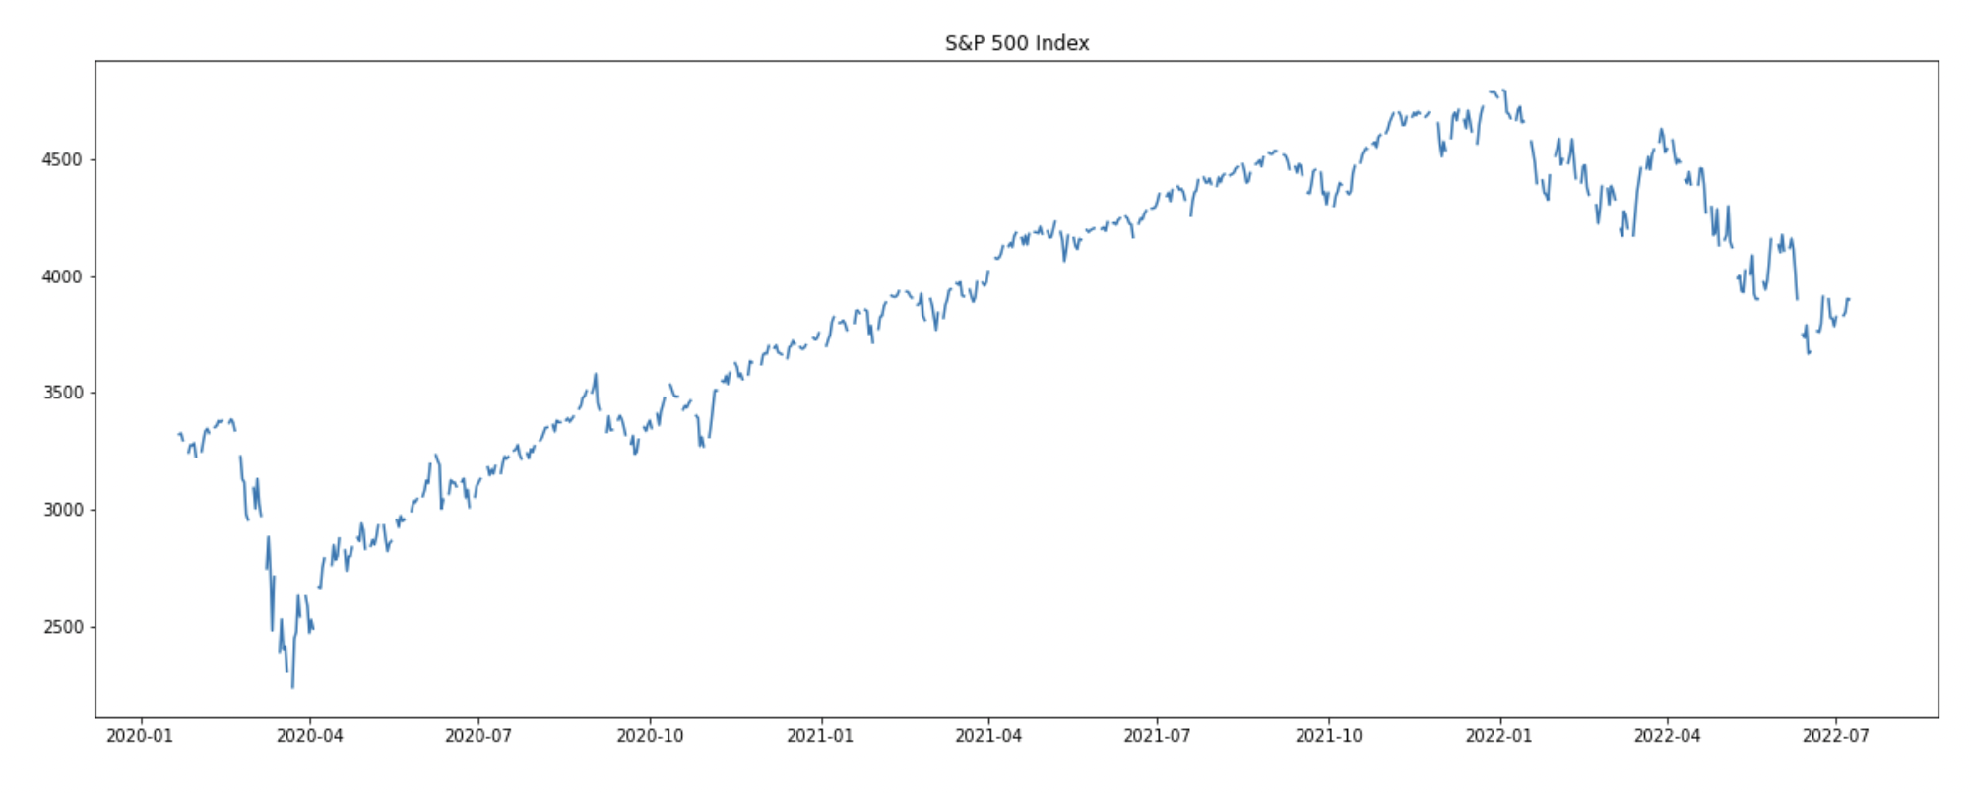
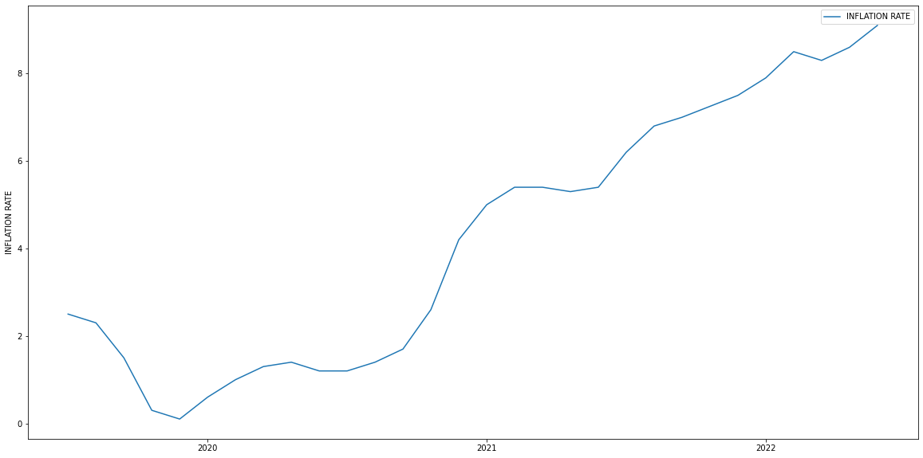
Analysis
Correlation : 0.928
Inflation rate with the S&P 500:
The correlation between S&P 500 and Inflation rate is 0.92. This quite a strong correlation,
However, doesn't mean the economy has improved due to inflation or vice versa.
After January 2022, the inflation rate hit an all time high of 9.1, coincides with the drop in the index.
Correlation != Causation

Slide 20
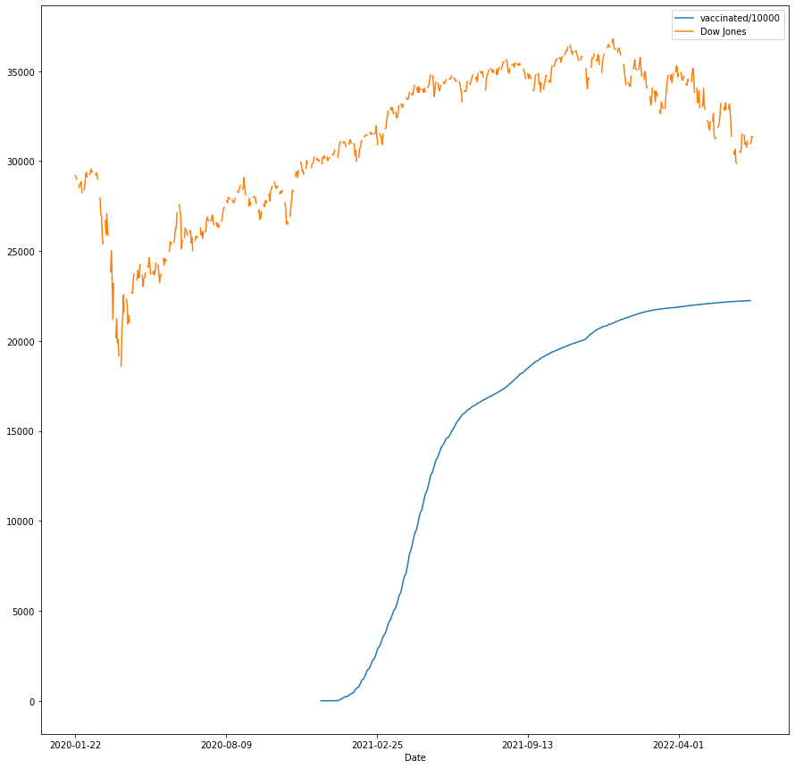
Analysis
Correlation : 0.677
People fully vaccinated and the Dow Jones Index:
Whole 2021 was recovery period.
The stock started rising as the bulk of the US population started getting vaccinated.
In 2022, the Dow Jones and other stocks began to decrease. This has nothing to do with the vaccination rate, and instead correlates with the inflation rate, and other factors.
Strongly Correlated, Until 2022

Slide 21
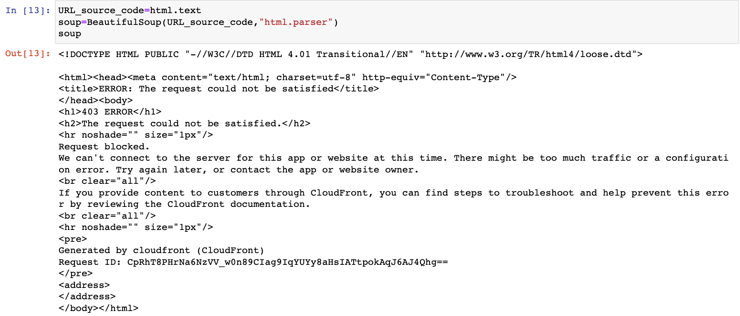
Challenges
With a number of variables, a lot of data to be collected to get better insights
Large Amount of Data
Data sets scraped have Null values
Many Null Values
Many of the sites we chose had blocked scraping
Many Blocked Sites
No daily inflation rate data, could not map it on the same graph as the other datas collected
Inflation Rate Data

Slide 22
Conclusion
The amount of daily cases was somewhat relevant to stock prices around 2020 but ever since, the world has adjusted to the virus and we now can barely attribute market losses to daily infections
Cases
The daily death rate did not make much of an impact on the economy. Although they correlate at some points, it’s the daily cases that really disrupted people’s lives and the economy.
Deaths
Vaccination
Rate
There was a fairly strong correlation between the vaccination rate and S&P 500, as well as the Dow Jones, especially in 2021 when vaccines were starting to be made available.
As the inflation rate skyrocketed to levels unseen in 40+ years in 2022, the stock indices fell considerably. These have a strong negative correlation, in 2022, when inflation increased as a result of other internal and external factors.
Inflation
From our analysis we found that a lot of data we expected to correlate did not correlate strongly within the whole time frame, but correlated in certain years. E.g. the daily cases has a weak positive correlation with all indices, but had a strong negative correlation in 2020.
Timeframe was too wide

Slide 23
Next Steps
Analysing whether stock market and sentiment correlates with Covid-19 data
Sentiment Analysis
Setting of tariffs and barriers between the world’s the two biggest economies
Sino-US Trade War
Covid waves in trading partner countries’ impact on US businesses and supply chains
Trading Partners
How to make the analysis more accurate?
Ukraine War & Oil Prices
The stock indices fell at the beginning of 2022 could be due to the War, Inflation Rate and Oil Prices
Time-Specific Correlation
Studying the 2020 data alone would show a stronger correlation, as the economy was still in shock

Slide 24
Citations
Banton, C. (2022). An Introduction to U.S. Stock Market Indexes. https://www.investopedia.com/insights/introduction-to-stock-market-indices/
Mathieu, E., Ritchie, H., Ortiz-Ospina, E. et al.(2021). A global database of COVID-19 vaccinations. Nat Hum Behav https://ourworldindata.org/covid-vaccinationshttps://ourworldindata.org/covid-vaccinations
The Pydata Development Team. (2020). pandas-datareader. https://pandas-datareader.readthedocs.io/en/latest/
Worldometers.info - USA Coronavirus Data https://www.worldometers.info/coronavirus/country/us/
Current US inflation rates: 2000-2022: US inflation calculator. (2022, July 13). Retrieved July 17, 2022, from https://www.usinflationcalculator.com/inflation/current-inflation-rates/

Slide 25
Questions and Answers

